Slide 1


SMART INDIA HACKATHON 2026
TITLE PAGE
Problem Statement ID – SIH26044
Problem Statement Title- Portal For Academia – Industrial collaboration for Skill Mapping, Internships and Placements.
Theme - Miscellaneous
PS Category - Software
Team Name(Registered on portal) – Code Catalyst

Slide 2

IDEA
Code Catalyst
AYUSH SkillBridge – AI-Powered Academia–Industry Collaboration Platform
Proposed Solution : AYUSH SkillBridge is an AI-powered platform that connects students, colleges, and industries. It performs skill mapping, identifies skill gaps, recommends courses, and provides internship and placement opportunities through a single portal.
How it addresses the problem
Innovation and uniqueness of the solution
Connects students, faculty, and industry.
Simplifies internships and placements.
AI-based skill gap analysis.
One platform for students, faculty, and industry.
Improves skills according to industry needs.
Helps industries find skilled candidates.
Smart job and internship recommend-ations.
Industry-driven curriculum improvement.

Slide 3
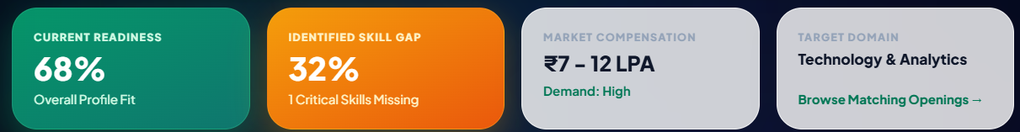
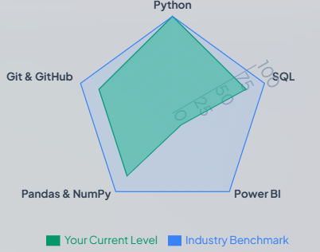
TECHNICAL APPROACH
Code Catalyst
Frontend: React.js / HTML, CSS, JavaScript
Backend: Node.js + Express.js / REST APIs
METHODOLOGY & IMPLEMENTATION
Student/Faculty/Industry Data
Database: PostgreSQL / MySQL
Deployment: Cloud-based scalable architecture
Skill Extraction
Skill Mapping
TECHNOLOGIES TO BE USED
Skill Gap Analysis
AI Match Score
AI/ML: Python, NLP & skill-matching algorithms
Integration: Job & internship APIs, learning/certification platforms
Skill Gap Analysis
Personalized Learning
Authentication: Role-Based Access Control (Student / Industry / Faculty / Admin)
Application Tracking
Internship/Job Recommendation
Analytics

Slide 4
FEASIBILITY AND VIABILITY
Code Catalyst
📊 Data Quality
🤖 AI Accuracy
🔐 Data Privacy
🤝 Industry Adoption
⚙️ FEASIBILITY
2
3
1
⚠️ CHALLENGES
🛡️ MITIGATION
💻 Tech Ready – Web + AI
📊 Data Driven – Skills & Jobs
📈 Scalable – College → National
💰 Low Cost – Cloud Based
🔄 Regular Data Updates
🧠 AI + Feedback Loop
🔒 Secure Access
🤝 Pilot + Partnerships
👨‍🎓 Student Data → 🤖 AI Matching → 📊 Skill Gap → 📚 Learning → 💼 Jobs/Internships

Slide 5
IMPACT AND BENEFITS
Your Team Name
Code Catalyst
🎯 Potential Impact on Target Audience
💡 Benefits of the Solution
Students: Better career and skill alignment
Institutions: Data-driven skill development
Industry: Faster access to relevant talent
All stakeholders: Stronger academia–industry collaboration
Long-term: Improved employability and placement outcomes
Nationwide: Reduced academia–industry skill gap
Social
1. Better career opportunities
2. Increased youth employability
3. Reduced skill mismatch
4. Equal access to career guidance
Economic
1. Reduced hiring time and cost
2. Better talent utilization
3. Improved workforce productivity
4. Efficient recruitment pipeline
Educational
1. Industry-aligned curriculum
2. Real-time skill-demand insights
3. Personalized learning paths
4. Better placement readiness
Environmental
1. Reduced paperwork
2. Digital-first access
3. Fewer unnecessary physical visits

Slide 6
RESEARCH AND REFERENCES
Code Catalyst
National Education Policy (NEP) 2020 – Ministry of Education, Government of India National Education Policy 2020 – Official PDF
Ministry of Ayush – Government of India Ministry of Ayush – Official Website
Skill Development & Employability – MoE: https://www.education.gov.in/sites/upload_files/mhrd/files/nep/ABSS_Brochure_2022.pdf
India Employment Report 2024 – ILO & IHD: https://www.ilo.org/publications/india-employment-report-2024-youth-employment-education-and-skills
Global Employment Trends for Youth 2024 – ILO: https://www.ilo.org/publications/major-publications/global-employment-trends-youth-2024
Shiksha Samagam – Industry–Academia Collaboration: https://www.education.gov.in/sites/upload_files/mhrd/files/nep/ABSS_2024_Outcome_Document.pdf

